Slide 1



A client checklist for Government Funding
FBIA 2015
Government Resources
Ricardo Garcia
Government Resources Program

Slide 2

Agenda
Government funding opportunities
Our Program
Overview
Tools
Resources
Federal Government Registration Checklist
Government Resources Program

Slide 3
Government Funding Opportunities
Government Resources Program

Slide 4

Why sell to the Government?
The U.S. Government is the world’s largest buyer of goods and services
They procure over $600+ Billion annually.
They advertise their specific needs well in advance.
They clearly specify purchasing ground rules
There are many Government agencies and programs available to help.
Government Resources Program

Slide 5

How to determine if your clients should do business with the Government?
Opportunity Analysis
Is Government business right for your client company?
Will the new revenue stream help the company’s growth?
Market Analysis
What does the market look like?
Are there relevant grant or contract opportunities for your company?
How much is the Government Spending in this space?
Who are some key players in this space?
Identify potential collaborators/competitors
Government Resources Program

Slide 6

Small Business Set-Aside
SBA’s Role in Government Contracting
They recognize that Small businesses have always been the engine for economic growth.
SBA works with federal agencies to award at least 23% percent of all prime government contract dollars to small businesses and help federal agencies meet specific statutory goals.
Government Resources Program

Slide 7
Government-wide Statutory Goals
Small Business | 23 % of Prime Contracts
Small Disadvantaged Business | 5 % of prime & subcontracts
Woman Owned Small Business | 5% of prime & subcontracts
HUB Zone | 3% of prime
Service Disabled Veteran Owned Small Business | 3% of prime & subcontracts
Government Resources Program

Slide 8
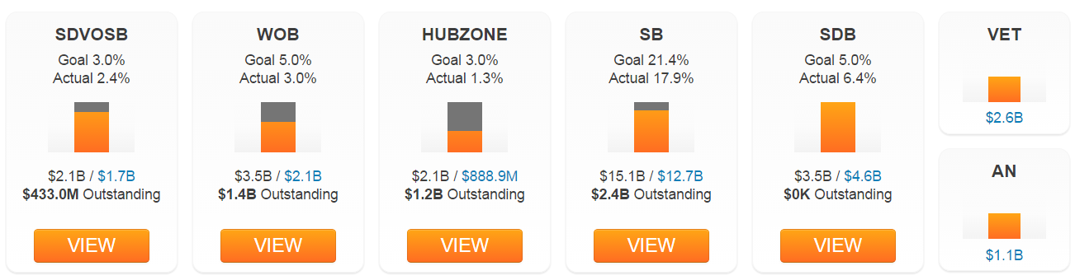
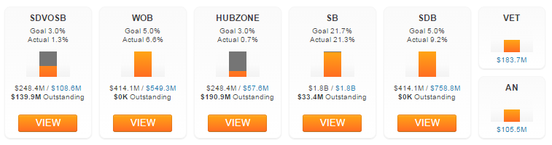
Government-wide Statutory Goals Spending/Goals FY2015
Department of Defense
Department of Health and Human Services
Government Resources Program

Slide 9
Program Overview
Government Resources Program

Slide 10

Services provided to UCFBIP clients
Evaluate a company’s readiness to do business with the Government.
Provide overview on the procurement & grant process
Guidance on the registration process
Identify opportunities
Federal, State & Local
Grant opportunities
Market Analysis
Analyze spending trends, needs and opportunities.
Access award history and expiring contracts
Competitor/Collaborator Analysis
Government Resources Program

Slide 11
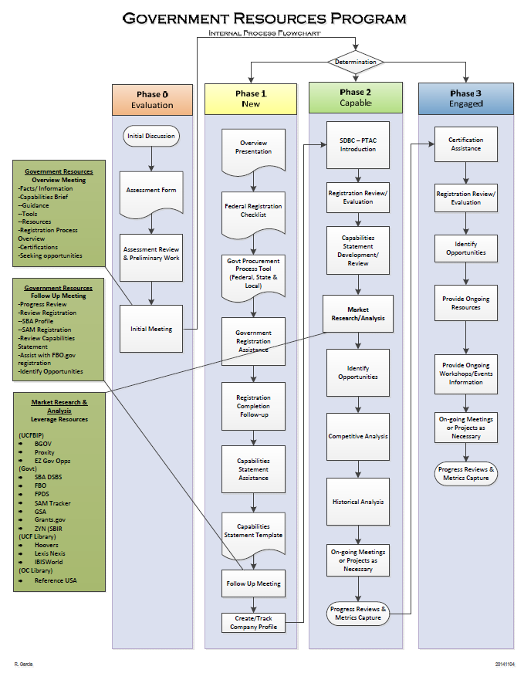
Program Overview
Phase 0 – Evaluation
Assessment Form
Initial Meeting
Determination
Phase 1 – New
Registration Guidance
Phase 2 – Capable
Market Analysis
Phase 3 – Engaged
Identify Opportunities
Assistance pursuing opportunities
Government Resources Program

Slide 12
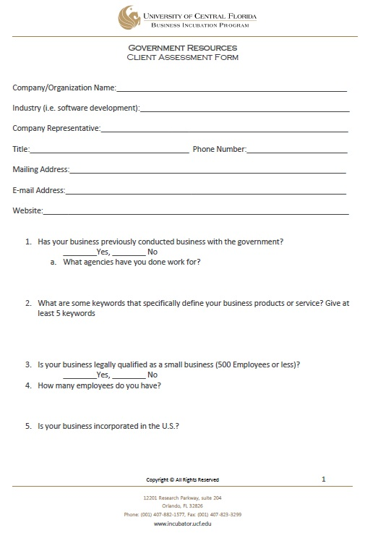
Evaluation
Assessment Form
Designed to help us identify and address your specific needs in the Government space
Determine where we can provide focused assistance
Please complete and return
Government Resources Program

Slide 13
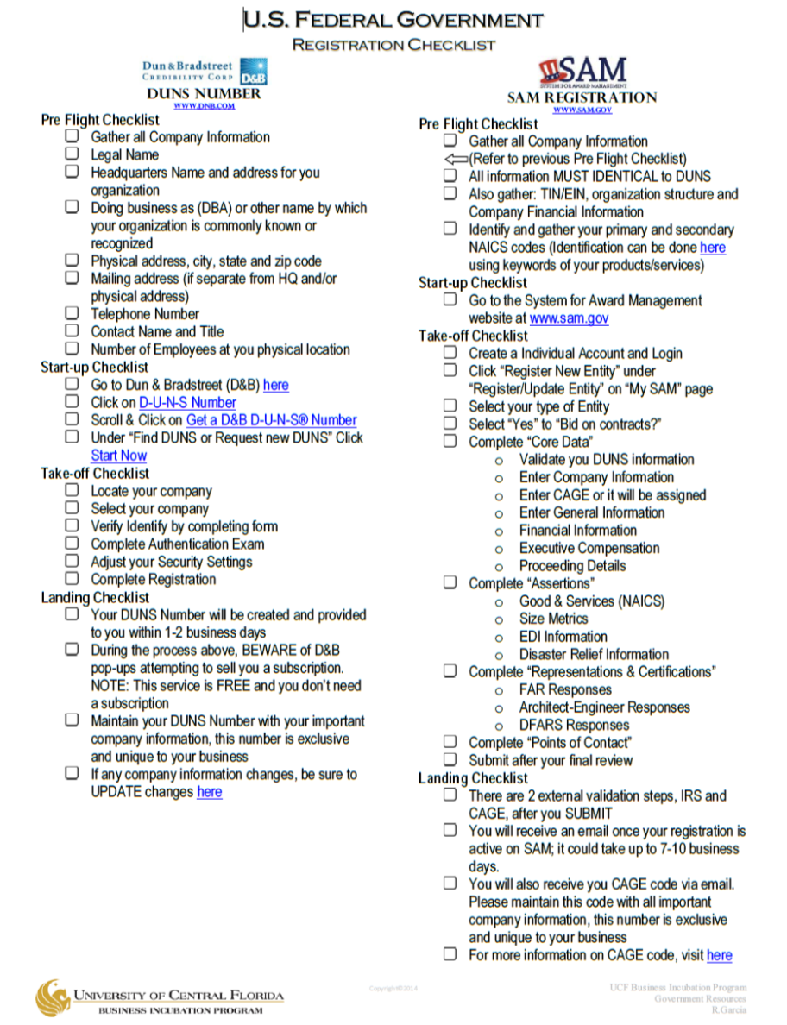
Tools Overview
Registration “Flight” Checklist
Designed to streamline the registration process.
Following this checklist the company will:
Obtain a DUNS number
Identify NAICS codes
Register with SAM
Obtain a CAGE code
Download
Government Resources Program

Slide 14
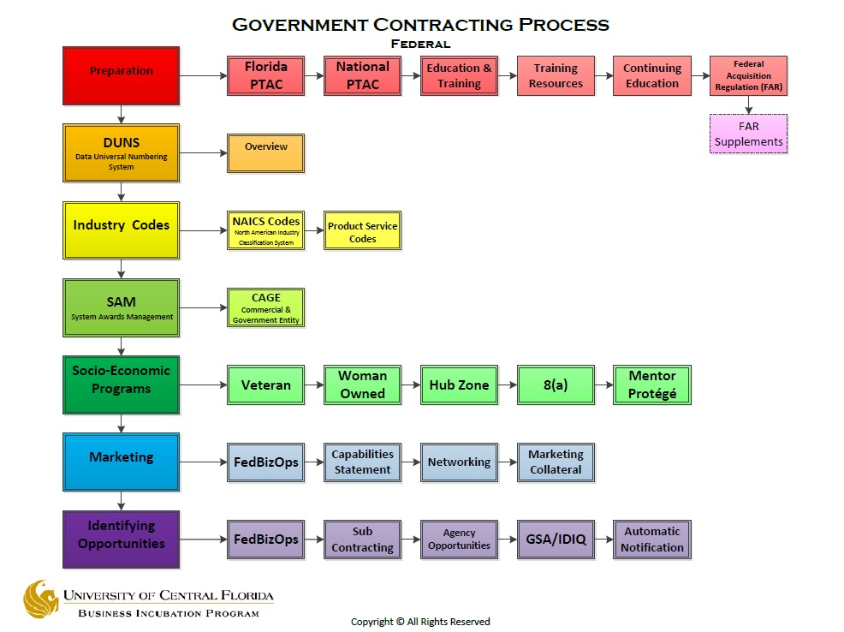
Tools Overview
Government Resources Program

Slide 15
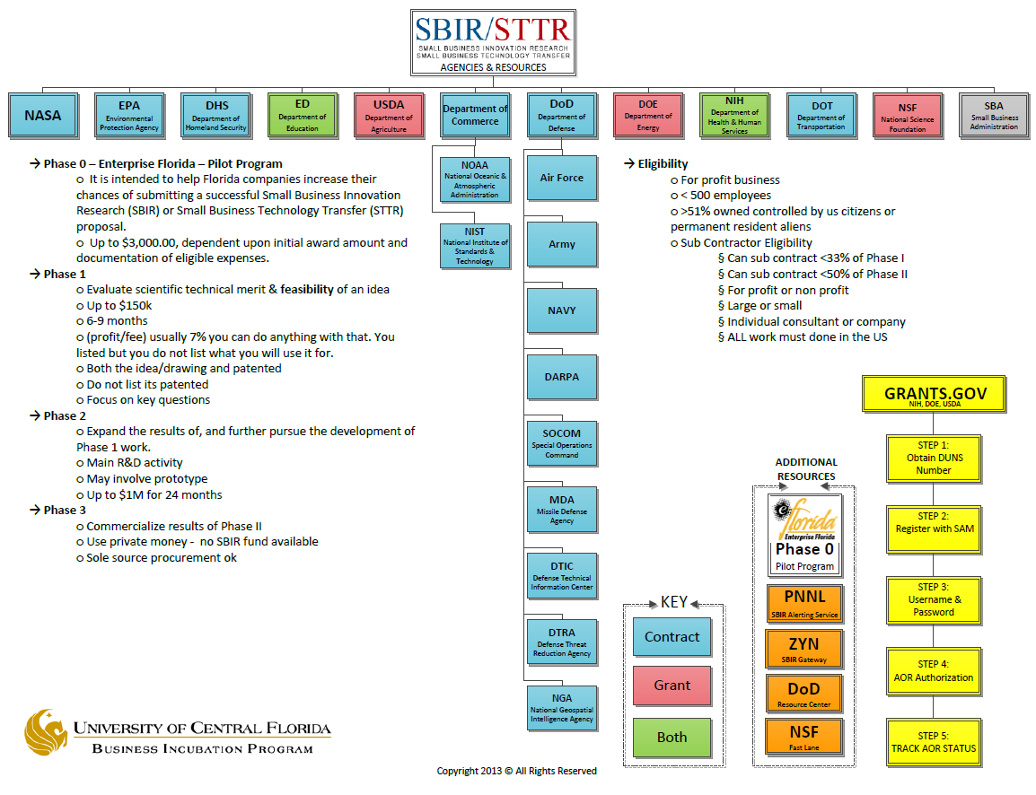
Tools Overview
Government Resources Program

Slide 16



UCF BIP Resources
BGOV is an online platform that provides data, references, analysis and workflow tools on Government procurement. It provides the ability to analyze spending patterns across agencies, competitors and contracts.
Bid monitoring system and single point of entry database. Monitors All Federal agencies & over 2,000 State and Local Governments.
Online platform that allows a company to Identify, qualify and pursue federal government contracts, bids and RFPs. Provide market intelligence, data integration and team collaboration
Government Resources Overview
Notes:
BGOV: www.bgov.com
Capabilities:
Strategic Research
Market Intelligence & Analysis
New Opportunities
Workflow Tools
Offers free webinars
Proxity: http://www.proxity-ec.com/
Capabilities:
Active Government Opportunities
Expiring Contracts
Award History
Find Contracting Officers
EZGovOpps: https://ezgovopps.com/home/
Capabilities:
Market Intel
Identify Opportunities
Team Collaboration
Competitor Comparison
20% discount to exclusive to Incubator Clients

Slide 17

Government Grants
The Small Business Innovation Research (SBIR) and the Small Business Technology Transfer Research (STTR) are federal programs that enable small businesses to compete for research dollars to test, prototype and commercialize new solutions for needs identified by participating federal agencies.
Government Resources Program

Slide 18
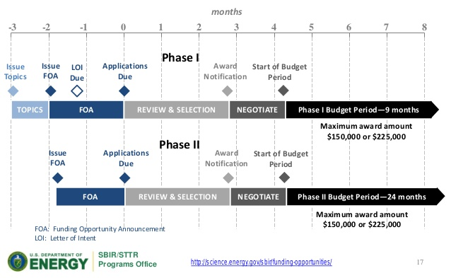
SBIR/STTR Structure
Phase I
Feasibility Study, Proof of Concept
Up to $150K for 6 Months
Phase II
Full R & D Effort
May involve prototype creation & testing, clinical trials
Up to $1M for 12 Months
Phase III
Commercialization Stage
Seek external funding (non-SBIR Federal Funding or Private Sources)
Application & Award Timelines
Government Resources Program
Solicitation
Topics
Proposal Submission
Evaluation
Phase I
Award

Slide 19

SBIR/STTR
Phase 0
It is intended to help Florida companies increase their chances of submitting a successful Small Business Innovation Research (SBIR) or Small Business Technology Transfer (STTR) proposal.
Up to $3K for eligible expenses
Consulting Fees: supporting tech development, commercialization strategies proposal review
Professional Fees: Legal, Accounting
Writing services, travel, etc.
Info
Government Resources Program

Slide 20
SBIR vs. STTR
For SBIR the small business must perform 2/3 of the R&D in Phase I and at least 50% in Phase II. The Principal Investigator must be employed by small business and cannot work full time for another employer.
For STTR the small business must partner with a research institution and the small business must perform 40% of the R&D in Phase I & II
Government Resources Program

Slide 21

SBIR/STTR Award & Success
FY 2014 Awards
5,086 Awards, Totaling $2.1 Billion
Success Ratios
Phase I | Success Ratio | Average Award
SBIR | 16% | $151K
STTR | 21% | $144K
Phase II | Success Ratio | Average Award
SBIR | 59% | $500K
STTR | 39% | $582K
*Overall for FY 2012
Government Resources Program

Slide 22

Government Funding
Broad Agency Announcements(BAA)
BAAs are solicitation methods for R&D efforts.
The objective is to encourage participation by science and technology firms and educational institutions in meeting the U.S. Government’s R&D goals for innovation .
Government Resources Program

Slide 23





Broad Agency Announcements(BAA)
The total dollar value or range of dollar values as well as anticipated period of performance may be stated in the announcement.
Generally require 3-5 page white paper
AFRL – BAA Guide
Government Resources Program

Slide 24

Subcontracting
Great way to “get foot in the door” in government contracting.
Resources
Subcontracting Databases:
SBA Subcontracting Network SUB-Net
SBA – Subcontracting Opportunities Directory
Florida
GSA Subcontracting Directory
Agency Websites
DoD Subcontracting Program
Industry Organizations & Events
NDIA
WID
National Center for Simulation
Team Orlando
Government Resources Overview

Slide 25
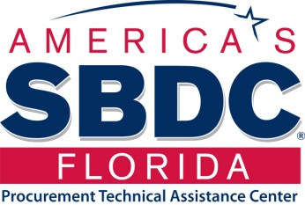
Resources
FSBDC/PTAC: Government Contracting Services
FSBDC/PTAC was created to assist established Florida businesses with government contracting and procurement support services including but not limited to:
Marketing to Government
Proposal preparation
Contract administration
Socio-Economic classifications
List of PTACs in Florida
Government Resources Program

Slide 26



Resources
Resources to help your client companies discover the market:
Grants
www.zyn.com
www.sbir.gov
www.grants.gov
Contracts
www.FedBizOpps.gov
www.fpds.gov
Government Resources Program
Notes:
Resources to conduct market analysis.

Slide 27


State Resources
The Florida Virtual Entrepreneur Center is a free web portal designed to connect entrepreneurs with business support organizations, programs and service providers who can support their new or growing business.
The Florida High Tech Corridor Council is an economic development initiative of three of the country’s largest research institutions—the University of Central Florida, the University of South Florida and the University of Florida. The Council’s mission is to grow high tech industry and innovation through partnerships that support research, marketing, workforce and entrepreneurship.
Enterprise Florida, Inc. (EFI) is a public-private partnership between Florida’s business and government leaders and is the principal economic development organization for the state of Florida.
Government Resources Program

Slide 28

Questions?
Government Resources Program

Slide 29
Ricardo Garcia
Government Resources Manager
UCF Business Incubation Program
Ricardo.Garcia@ucf.edu
Office: 407-823-2346
Cell: 321-662-3121
Government Resources Program

